Slide 1
CS3SC19 Social, Legal and Ethical Aspects of Computer Science
Dr Pat Parslow
p.parslow@reading.ac.uk
Notes:
Hello, and welcome to CS3SC19, possibly one of the more confusing course, codes, social legal and ethical aspects of computer science. I'm Pat Parslow. you can contact me at P.parslow@reading.ac.uk.

Slide 2
First of all, let me introduce myself
Dr Pat Parslow
(call me Pat, unless it is formal, in which case Dr Parslow)
Industry experience as software developer, software engineer, software training professional, IT support (and various other things!)
I teach Software Engineering (part 1), Software Quality and Testing (part 2), and Social, Legal and Ethical Aspects of Computer Science (part 3).
Contacting me
Email is generally best (p.parslow@reading.ac.uk)
“Dear Pat,” “Hi Pat,” or even just “Pat,” but not “Hey” or “Hey Pat,”.
Happy to have Teams meetings with you (individually, or in small groups)
Notes:
First of all, let me introduce myself properly. , If you are contacting me, please call me Pat., unless it's a formal matter, in which case dr. Parslow will do. I'm not a professor, my industry experience as a software developer, software engineer, software training, professional, it support, and various other things led me to an interest in ethics and the law. As you all probably aware, I teach software engineering in part one.Software quality and testing in part two and social legal and ethical aspects of computer science in part three, when emailing, please use Dear Pat, hi pac, or even just Pat as a greeting, not hey or Hey Pat. because I don't take particularly kindly to it. Okay. I'm very happy to have teams meetings with you individually or in small groups.

Slide 3
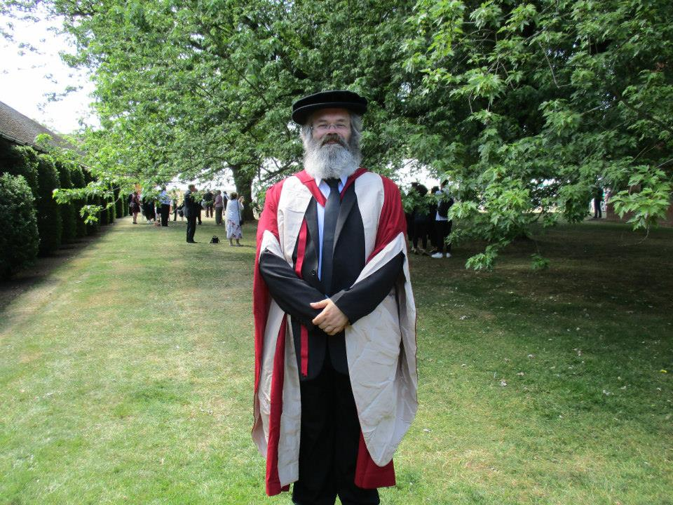
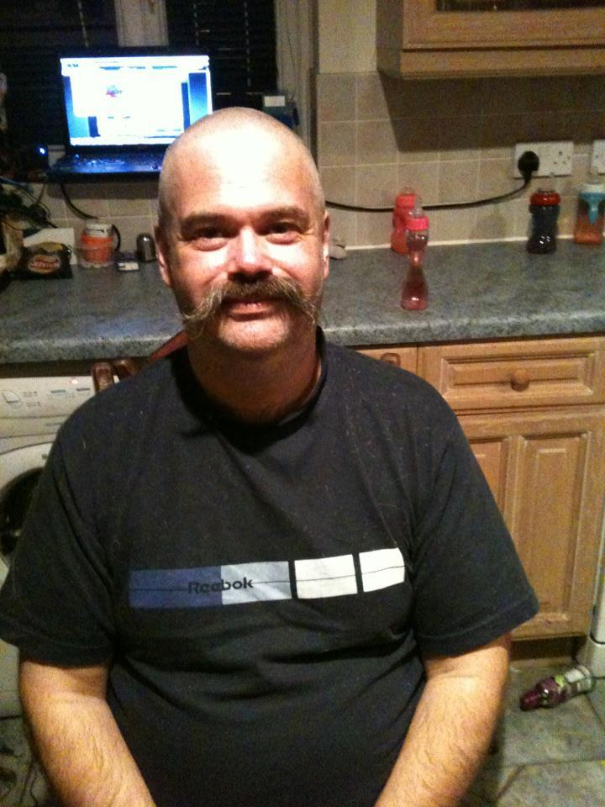
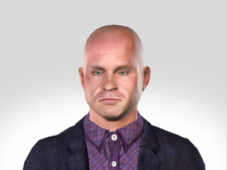
I look like this…
Or sometimes this
But mainly in these slides I will, perhaps inexplicably*, look like this: *there is a reason!
Notes:
Almost all of you probably know me but I look like this in case you weren't sure. Um, sometimes I have been seen in gallons, but that's generally just the graduation. Um, quite often in jeans, tee shirt, the main thing is that my amount of hair will vary a lot. Um, on these slides though, I will be represented by an animated talking head there a reason for it, which we will discuss later in the course.

Slide 4
Versions of these slides
The slides are provided on Blackboard
Without accompanying ‘talking head’ narration
With accompanying ‘talking head’ narration
As a video of the whole slide deck.
Transcripts (automatically produced, may contain some errors) are included in the ‘notes’ section of the slides
On With The Content!
Notes:
These slides will be provided on Blackboard. Um, and there will be three basic versions, one without the accompanying talking head one with the accompanying talking head. Um, and as a video of the whole slide deck. Transcripts, which will be automatically produced, may contain some errors, um, and will be included in the notes section of the slides.So let's get on with the content.

Slide 5
A word on studying
In a normal year the ‘lectures’ involve me giving an outline of the topic and expecting you to read around the subject, discuss and own your own learning.
This year, in that respect, is little different (but of course, the main mode of delivery is pre-recorded online material)
Read the resources provided on blackboard.
Practice reflecting on decisions you make.
Notes:
First of all a word on studying; in normal year lectures involve me giving an outline of the topic, um, and expecting you to read around the subject, discuss with friends, your peers, um, and to own your own learnin. This year, isn't going to be really much different. It will be prerecorded online instead of being a face to face lecture.Later in the term, we will have some face to face sessions to support, particularly, uh, your group work and main individual essay report. You should read the resources supplied on Blackboard and you should practice reflecting on decisions you make, particularly from an ethical and legal perspective.

Slide 6
Assessments
4 – two online tests, a group work, and an individual piece of work
Online tests on Ethics and on Law
You will have a 2 week window in which to do these.
They will probably overlap one another.
They only have a few questions in each.
The Law test requires you to cite sources and explain why those sources were useful.
Do not rely on the ‘author’ to claim accuracy!
Notes:
I mentioned the sexbots (ahh, transcription software... assessments, not sexbots!) .Um, there are four, two are online tests, um, theres a group work and there's an individual piece of work. The online tests on ethics and law, are, possibly in some ways the easiest pieces of work. Um, although they don't always get the highest marks. And I suspect that is because people leave them until the last moment.Each one you will have a two week window for. Um, the windows may overlap. There are only a few questions in each nine or 10 from memory. Um, the law test requires you to cite your sources in the final part of the, the test, and to explain why those sources were useful. Don't rely on the author to claim accuracy.It is an unfortunate fact that even web pages provided by her Majesty's government. Uh, occasionally. Not actually true representations of things, such as the law.

Slide 7
Group work
I will assign groups
Experience tells us that this increases the learning, and the attainment level (marks!)
The work involves watching a near-future sci-fi film or TV series (couple of episodes, sometimes one will do), and examining the social, legal and ethical implications of the changes in technology between it and the world today.
It is best to watch the source material together Social distancing suggests that this will be best done by being online together when watching, but you may find alternative approaches.
Notes:
Um, the group, work, I will assign groups and I can hear your collective cry of outrage at this point. Um, but experience tells us that this increases by the learning and the attainment level, the monks.It's important for a point of view of the ethics in particular and the social aspects, because the groups will be designed to try and get a cross section, a range of people from different backgrounds, different nationalities, et cetera, um, different experience. And that helps when you are discussing. And it basically forces you to look at different people's points of view.Whereas if you. Get together with all your best mates, the chances are that you will much more likely that you will have a limited range of views involved in doing the work. The piece of work itself involves watching a near future scifi film or TV series. Um, a couple of episodes, sometimes one will do, um, and examining the social legal and ethical implications of the technologies in that, um, in comparison to today.It is best to watch the source material together. Um, social distancing obviously means that you may want to do that by watching it while being online together rather than physically present

Slide 8
Group Work
Do not just split the work up in to “Legal”, “Social”, “Ethical” and have one or two people do each part and then try to put the pieces together.
This does not: a) lead to the best marks b) help you all develop your awareness of the topics
Each person must create a short list of SLE topics the film raises, and submit it on a CSGitLab repository shared by the team.
I recommend using Issues management
Notes:
is also rather important that you do not just try and split the work up into legal, social, and ethical or any other operatory way of doing it, and then try and match the results together into a report.It hardly ever reads well, you get duplicate points being made. You get contradictory points being made. The writing very seldom actually joins up and looks like it's been authored by a single person or a team, you know, a proper organized team. And as a consequence, it ends up generally not being as good as not getting best box.So each person must create a short list of SLA topics that the film raises and submitted on a CS, get lab repository shared by the team. If you need help setting up the repository, let me know. Um, I'm sure that between each team you should have enough experience of using CS get lab by now, to be able to organize that.Um, I recommend for that list of topics using the issues management. And you can use that to then break down and discuss as a team, which bits are most important, how you're going to approach them in the report. And then at some point you can split the task of actually writing the report into separate sections for different people

Slide 9
Social, Legal, Ethical
Social
Almost all software we create is for, or affects, people
Social responses to systems we create can vary
Does everyone like targeted adverts, or autonomous robots, or autonomous vehicles?
Does everyone like facial recognition systems and surveillance cameras?
Does everyone like social media?
Society’s view of things can vary, depending on place, time and recent events.
Society’s view of things is often swayed by influential voices.
Notes:
So what's this about social legal, unethical social, almost all software we create is for, or affects people if it doesn't, why are we doing it? And the social response is to systems that we create can vary. Some people like to talk to that votes others don't. Some people liked the idea of autonomous robots, others don't.Some people liked the idea of autonomous vehicles. It as cars, others don't. Does everyone like facial recognition systems? Are there any ethical issues or sexual (social. I said social. The transcription software is obsessed!) issues involved there and surveillance cameras? Does everyone like social media society's views of things can vary depending on the place, the time and recent events society's views of things are often swayed by influential voices.We have the concept these days of the social media influencer, and these don't always work to the benefit of society.

Slide 10
Social, Legal, Ethical
The Law
This varies between different places, and different times
Often created through social influence
Not always, sometimes by “lobbyists” acting against social interests
In UK, two main types – common law and statutes.
Statutory laws are the ones created in Parliament
And those created by regulations
Common laws have existed since before we had a democracy, but are also created by the legal rulings of judges sitting in court
Distinction between “criminal” and “civil” law
Notes:
We also have the law. This also varies between different places and different times. Um, you will probably be aware at the moment with the pandemic for instance, that the laws, which tell you what you can and can't do can vary not only between individual countries within the UK Wales, Northern Ireland, Scotland, and England, uh, but actually between different towns.So you can have different restrictions. Uh, we've always had that ability. There are things called bylaws, which will relate to a particular town, for instance,The reason that we get different laws. Um, and the fact that laws change over time is often because they are created through social influence. Um, the popular view is that we must have a law to deal with such and such, but that's not always the case. Sometimes laws are created by lobbyists acting against the general social interest.In the UK, there are two main types of law, common law and statutes, statutory laws are the ones created in parliament. And those created by regulations, which aren't necessarily, um, overseen directly by parliament and common laws, which have existed since before we even had a democracy, uh, but are also created by the legal rulings of judges.When they're sitting in court, this idea that. I judge makes a judgment and then other judges have to follow it. That's not always the case. It depends on the seniority of the levels of judges. There is also a distinction between criminal and civil law, criminal law, basically other things which you can be arrested for breaking and civil laws, other things which allow another citizen to take you to court, to Sue you, to try and stop you from behaving the way you're behaving.

Slide 11
Social, Legal, Ethical
Ethics
The ‘right’ and ‘wrong’
Many different ethical “frameworks”
We will mainly look at Utilitarian and Deontological ethics
But may touch on others
“Ethics approval”
Not to be confused with the concept of “Ethics”
Important to abide by institutions Ethics policies
Final Year Projects – approval may be required!
Notes:
Um, then let's look very briefly at the idea of ethics. Ethics is about the rights and wrongs. Um, there are many different ethical frameworks. We'll look mainly at utilitarian and deontological ethics, but we may touch on others during discussions, note that there is a distinction, ethics approval is something about getting.Um, approval from an institution under its ethics policies. So finally, a project for instance, may need to get ethical approval if they are doing things which involve collecting human data. And I'll ask some questions at the end of this, uh, session, uh, to get you thinking about what might be collecting human data and what might not.

Slide 12
Ethics
 | Consequentialist | Duty | Virtue
Deliberative process | What kind of outcomes should I produce (or try to produce)? | What are my obligations in this situation, and what are the things I should never do? | What kind of person should I be (or try to be), and what will my actions show about my character?
Focus | Directs attention to the future effects of an action, for all people who will be directly or indirectly affected by the action. | Directs attention to the duties that exist prior to the situation and determines obligations. | Attempts to discern character traits (virtues and vices) that are, or could be, motivating the people involved in the situation.
Definition of Ethical Conduct | Ethical conduct is the action that will achieve the best consequences. | Ethical conduct involves always doing the right thing: never failing to do one's duty. | Ethical conduct is whatever a fully virtuous person would do in the circumstances.
Motivation | Aim is to produce the most good. | Aim is to perform the right action. | Aim is to develop one’s character.
A brief summary
© Brown University https://www.brown.edu/academics/science-and-technology-studies/framework-making-ethical-decisions
Notes:
There's quite a nice summary from Brown university. Um, on different types of ethical frameworks, um, the three columns here, consequentialist duty and virtue are three main categories of, um, ethical theory consequentialist. Um, the main one, there is utilitarian ethics and it's about the greatest good for the greatest number.Um, the bottom row of this table says that motivation is the aim to produce the most good. There are alternatives to that, for instance, the aim to produce the least harm, um, because that sometimes may be a better way of considering the actions you're about to take. GT ethics. This is the idea of deontological ethics.It's about thinking about what you should and shouldn't do what's right and wrong. It's not about the ultimate. Um, Results it's about the way you do it. So the consequentialist idea is that the ends sometimes justify the means. Um, the duty view is that that isn't the case, that the, the means must be right to the way you do it must be right.And then there's virtue ethics, um, which is sort of about trying to make sure that you're doing the right thing and making yourself a better person. So it's. About trying to look at your character traits and thinking if I do this, will I be a better person for doing it?Um, I've given the link on the slide, which takes you to a really nice set of, um, a document on frameworks for making ethical decisions

Slide 13
PREVENT
A legal obligation to reduce risks of radicalisation…
But also institutional duties to support academic freedoms
Please note the statement on the BB assessment
If you are looking things up for coursework which may “attract the interest” of the security services, you MUST let me know, and only do those searches on university computers/network. This is for your own protection.
Notes:
Some of the things just in this introductory session, um, which need mentioning the prevent. Uh, which is a government scheme to try and reduce the amount of terrorism and extremists and radicalization that occurs.Um, and we have within the university, uh, our duty to take prevent into account. We also have institutional duties to support academic freedoms.Um, I think almost any government would really quite like to be able to say, Oh, we mustn't have people looking up certain types of content online because it might radicalize them, teach them how to make bombs, et cetera. Yeah. There's reasons why they might justifiably say we want to restrict access to things.On the other hand, they also tend to shy away from. Since the ship as such, because people don't like being told what they can and can't read and restricting academic freedom is a form of censorship. So we try not to allow academic freedoms to be restricted at the university. This means that we. Have to have a way of trying to stop you from getting into trouble.If you are searching for things which, um, the security services might find of interest. So if you find that you are looking things up for coursework, which may attract the interest of security services, you must let me know. And you must only do those searches on campus, computers and network. Once you have permission to continue.We are not in the business of stopping you from doing I rigorous academic, uh, search for material that relates to the topic. And obviously when it's to do with ethics and the law technology, there are potential areas where the secret services might be thinking, why are they looking that up? Um, if you are doing it entirely on your own computer, they're in your bedroom, in your, uh, whole residence or in your house, um, you know, with the light off, behind closed curtains, then they are likely to consider that you might be, uh, some sort of threat and investigate if you are doing it, having sought and obtained permission from the university, um, and doing it on the university computers.Then they are less likely to be thinking that you are up to no. Good. So it's for your own protection.

Slide 14
A word on Rights
Human rights, and other legal rights are not necessarily ‘fundamental’
Your right to freedom of expression only extends as far as it is not impinging on other people’s rights, for example
And only defends your right to express yourself from Government intervention
Rights are different in different countries.
It is unclear what Rights you will have in UK after full Brexit kicks in.
Notes:
Um, I also want to mention the idea of rights rights are sort of normally taken as being a big, uh, thing on laws. Um, and so for instance, the human rights act. Puts into place in the UK, currently the rights of people, and it's more or less in line with the European union's declaration of human rights under the United nations declaration of human rights.But they individual laws in individual countries in some cases are slightly different to what the fundamental rights claim.In all cases, though. The rights, the things like human rights as a concept give I'm not fundamentally, I'm sorry. I'm not fundamental rights. As in you are granted them. It's not that you definitely always have the right to do X, Y or Z. It's that the legal framework in which you live grunts you that right.Examples. Um, uh, that most rights actually. Can try it on the toes of other rights of other people. So your right to freedom of expression only extends as far as it's not impinging on other people's rights. Um, so hate speech you might have right to freedom of expression, but if you are doing something saying something or representing something in some way that incites others to violence against, for instance, say minority group.That is illegal. You do not have the right to do it despite having right to freedom of expression and freedom of expression. Also only defends your rights to express yourself from government intervention. So that rights stops the government in theory, from making laws, telling you what you can. And can't say you have to remember also that rights are different in different countries.And. In the UK in our current situation, it is unclear what rights you will actually have in terms of human rights or almost any other legal rights. After we get the full Brexit kick in, um, in January, at the moment, we still have our human rights act, but the government is once again, talking about getting rid of it.

Slide 15
A word on “politics”
We have political processes to create laws
We enforce laws based on political priorities
Anything to do with society is inherently political
A political ‘leaning’ is unavoidable
But so you can be aware of mine and interpret accordingly, I am, probably, an Anarcho-parliamentarian-social-democratic-monarchist and I don’t expect anyone else to be!
Your politics do not impact your marks
Your ability to base logical arguments on sound, well-referenced sources, does.
Notes:
Um, what about politics? He's. A fundamental fact that anything to do with social legal and ethical aspects of either thing is going to be in some way, political, we have political processes to create laws. We enforce laws based on political priorities. Um, anything to do with society is inherently political.Now. I am not seeking to change your political party affiliations the way you vote. Anything like that? That's, that's not my job. Um, but I, political leaning is unavoidable in order that you can be aware of my political leanings so that you can filter them out and see where I'm coming from. When I'm discussing things.Um, you should probably be aware that I would normally describe myself as being, I don't know, I parliamentarian sexual democratic monarchist, um, and I don't expect anybody else to be orientate to be able to understand what on earth. I mean, um, your politics do not impact your marks, your ability to base logical arguments on sound well, referenced sources does impact your marks.For instance, the daily mail. It's very seldom, a good source to use, even Wikipedia. Doesn't recognize it as a good source anymore.

Slide 16
Ethical or not?
Software to:
Launch denial of service attacks against others
Subtly alter messages on social media feeds
Improve car exhaust emissions when under test
Write programs from a test suite
Flag people up as suspects based on appearance
Adjust pupils’ marks based on their school
Detect plagiarism
Decompile other people’s programs
Automatically generate essays
Notes:
Um, it is worth considering as well, some questions, and I'm not going to give answers in this, um, recorded, um, lecture. Um, Perhaps some questions to think about all these things ethical or not software to launch denial of service attacks against suffers subtly alter messages on social media feeds, improve car exhaust emissions.When the car is under test right programs from a test suite, thus getting rid of computer programs, flag people up as suspects based on their appearance. Adjust to people's marks based on this school, detect plagiarism, decompile, other people's programs, automatically generate essays. Is it ethical to create those services, those pieces of software and the few think about it under different ethical frameworks.Does the answer change?

Slide 17
Collecting human data or not?
Observing users’ behaviour when using program
Observing program’s behaviour when using program
Asking user how they feel about the software
Asking the user if the software meets a requirement
Asking the user’s gender
Collecting height and weight information
And many others!
Notes:
And I said, I talk about a little bit about human data and collecting it. This is relevant to, um, Finally a projects. So if you are validating your farm and your project and you should be, um, to see whether it does what the requirements set it should do, you might well be wanting to observe the software in use, or you might be wanting to do, um, do a questionnaire or survey.So are these collecting human data or not observing the user's behavior when using a program, observing the program's behavior when using the program or asking the user, how they feel about the software, asking the user, if the software meets a requirement, asking the uses gender, well, age, collecting height and weight information, uh, there are many others here, so.Tracking the use of websites or tracking physically where they've gone using GPS, for instance, how I think about those, um, because the way you answer them is important and may well be important for your phone and your project in a subsequent, um, Sets of lecture slides. We will look in more depth of ethics in more depth, lots of different legal aspects, intellectual property, things like that.Um, and we will cover in more depth, some guidance on how to do the coursework.

